Slide 1
Computer Science
Dynamic Programming Algorithms
Samuel Lukas

Slide 2
Introduction
Dynamic programming is a very powerful algorithmic paradigm in which a problem is solved by identifying a collection of sub-problems and tackling them one by one, smallest first. Using the answers to small problems to help figure out larger ones, until the whole lot of them is solved.
In dynamic programming, Its nodes are the sub-problems we define, and its edges are the dependencies between the sub-problems. If to solve sub-problem B we need the answer to sub-problem A, then there is a (conceptual) edge
from A to B. In this case, A is thought of as a smaller sub-problem than B.

Slide 3

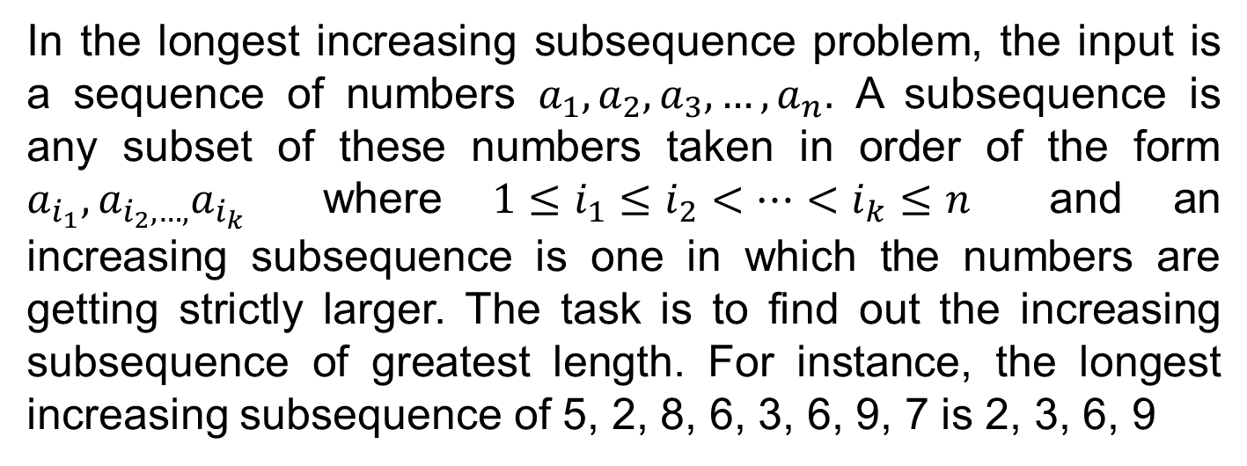
Example 01
In the longest increasing subsequence problem, the input is a sequence of numbers $a_{1},a_{2},a_{3},…,a_{n}.$ A subsequence is any subset of these numbers taken in order of the form $a_{i_{1}},a_{i_{2},…,}a_{i_{k}}$ where $1≤i_{1}≤i_{2}<…<i_{k}≤n$ and an increasing subsequence is one in which the numbers are getting strictly larger. The task is to find out the increasing subsequence of greatest length. For instance, the longest increasing subsequence of 5, 2, 8, 6, 3, 6, 9, 7 is 2, 3, 6, 9

Slide 4
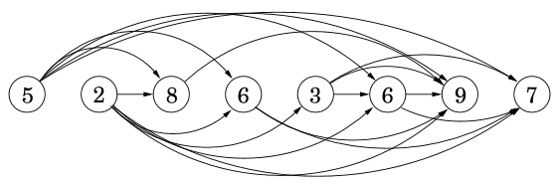
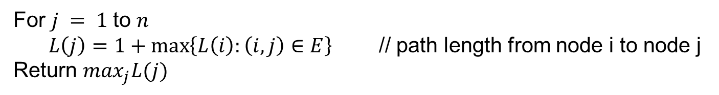
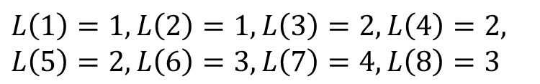
Solution Example 01 (cont)
Create path among all nodes
For $j = 1$to $n$
$L\left(j\right)=1+\max\left\{L\left(i\right):\left(i,j\right)∈E\right\}$ // path length from node i to node j
Return $\max_{j}L(j)$
$$L\left(1\right)=1, L\left(2\right)=1, L\left(3\right)=2, L\left(4\right)=2,$$
$$L\left(5\right)=2, L\left(6\right)=3, L\left(7\right)=4, L\left(8\right)=3$$

Slide 5

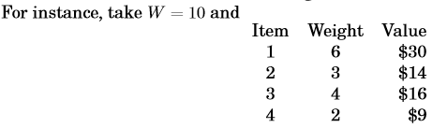

Example 02

Slide 6
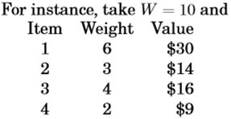
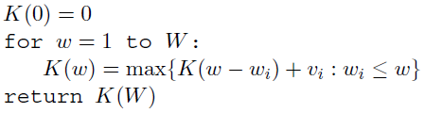




Solving by Repetition
$$K\left(1\right)=\max_{}\left\{K\left(0\right)\right\}$$
$$K\left(2\right)=\max_{}\left\{K\left(0\right)+9\right\}$$
$$K\left(3\right)=\max_{}\left\{K\left(0\right)+14,K\left(1\right)+9\right\}$$
$$K\left(4\right)=\max_{}\left\{K\left(1\right)+14,K\left(0\right)+16,K\left(2\right)+9\right\}$$
$$K\left(5\right)=\max_{}\left\{K\left(2\right)+14,K\left(1\right)+16,K\left(3\right)+9\right\}$$
$$K\left(6\right)=\max_{}\left\{K\left(0\right)+30,K\left(3\right)+14,K\left(2\right)+16,K\left(4\right)+9\right\}$$
$$K\left(10\right)=\max_{}\left\{K\left(4\right)+30,K\left(7\right)+14,K\left(6\right)+16,K\left(8\right)+9\right\}$$
Value $K\left(w\right)$as function of weight
w | 1 | 2 | 3 | 4 | 5 | 6 | 7 | 8 | 9 | 10
K(w)
0
9
14
18
23
30
30
39
44
48

Slide 7
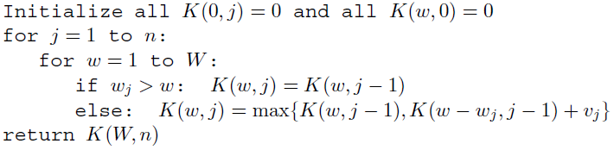


Solving by no Repetition
Value $K\left(w,j\right)$as function of weight and item number
J \ W | 0 | 1 | 2 | 3 | 4 | 5 | 6 | 7 | 8 | 9 | 10
1
2
3
4
0
0
0
0
0
0
30
30
30
30
30
0
0
0
14
14
14
30
30
30
44
44
0
0
0
14
16
16
30
30
30
44
46
0
0
9
14
16
23
30
30
39
44
46
$$K\left(10,3\right)=\max_{}\left\{K\left(10,2\right),K\left(7,2\right)+16\right\}$$
$$K\left(10,4\right)=\max_{}\left\{K\left(10,3\right),K\left(6,3\right)+9\right\}$$

Slide 8
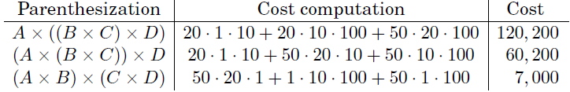
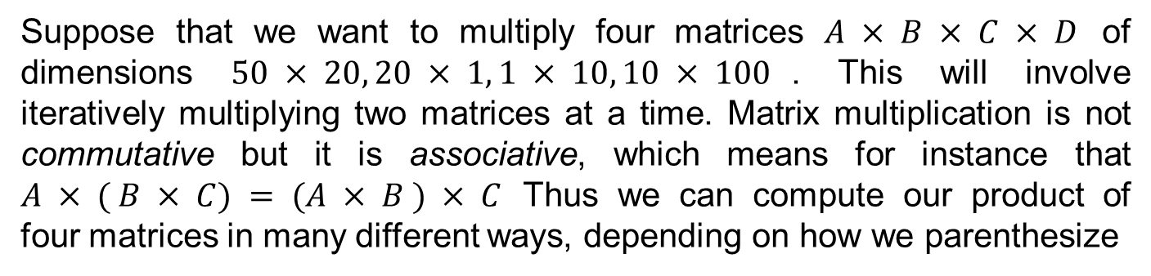
Chain matrix multiplication
Suppose that we want to multiply four matrices $A × B × C × D$ of dimensions $50 × 20, 20 × 1, 1 × 10, 10 × 100$. This will involve iteratively multiplying two matrices at a time. Matrix multiplication is not commutative but it is associative, which means for instance that $A × ( B × C) = (A × B ) × C$ Thus we can compute our product of four matrices in many different ways, depending on how we parenthesize
How do we determine the optimal order, if we want to compute $A_{1}×A_{2}×…×A_{n}$ with dimension $m_{0}×m_{1},m_{1}×m_{2},…,m_{n−1}×m_{n}$

Slide 9
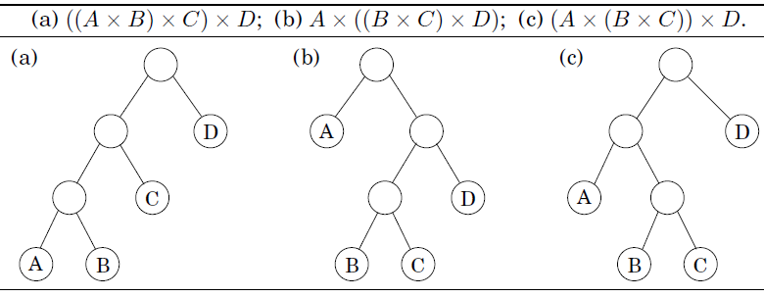
Representation of multiplication Order
a particular parenthesization can be represented very naturally by a binary tree in which the individual matrices correspond to the leaves, the root is the final

Slide 10
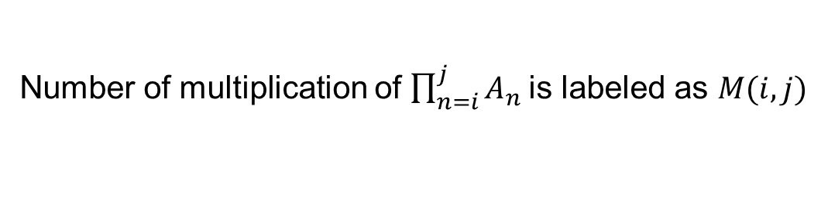
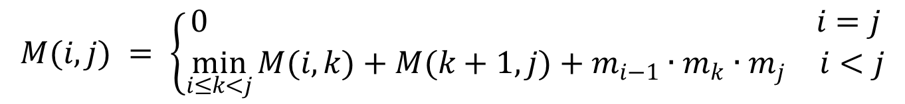
Problem Statement
Number of multiplication of $\prod_{n=i}^{j}{A_{n}}$is labeled as $M(i,j)$
$$M\left(i,j\right)=\min_{1≤i≤j≤n}{{\{{(A}_{i}×A}_{i+1}×…×A_{j})\}}$$
$$M\left(i,j\right)=\min_{i≤k<j}{{\{{(A}_{i}×A}_{i+1}×…×A_{k}) × {(A}_{k+1}×A_{k+2}×…×A_{j})\}}$$
$$∴M\left(i,j\right)=\min_{i≤k<j}{\{M\left(i,k\right)+M(\left(k+1\right),j){+m}_{i−1}∙m_{k}∙m_{j}\}}$$
$$M(i,j) = \left\{\begin{aligned}\begin{matrix}0 & i=j\end{matrix} \\ \begin{matrix}\min_{i≤k<j}{M(i,k)+M(k+1,j)+m_{i−1}∙m_{k}∙m_{j}} & i<j\end{matrix}\end{aligned}\right.$$

Slide 11

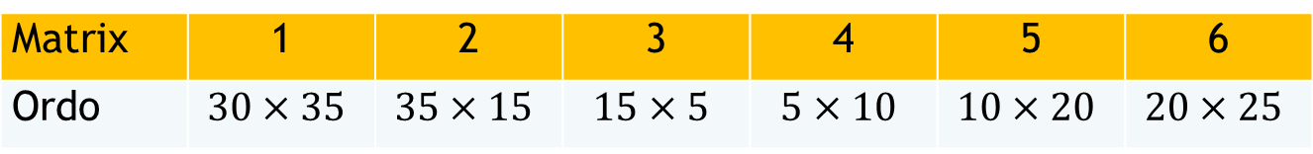

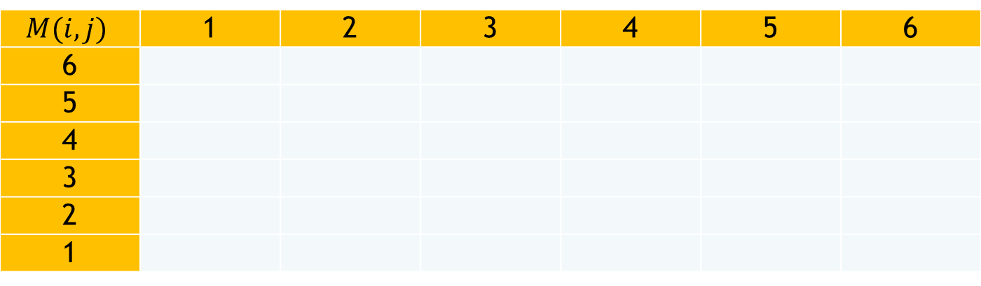
Example 03
Matrix | 1 | 2 | 3 | 4 | 5 | 6
Ordo | $$30×35$$ | $$35×15$$ | $$15×5$$ | $$5×10$$ | $$10×20$$ | $$20×25$$
$$M(i,j)$$ | 1 | 2 | 3 | 4 | 5 | 6
6
5
4
3
2
1
15125
10500
5375
3500
5000
0
11875
7125
2500
1000
0
9375
4375
750
0
7875
2625
0
15750
0
$∴M(2,5) = 7125$; $K(2,5) = 3$
0
$K$ denotes subproblem size

Slide 12
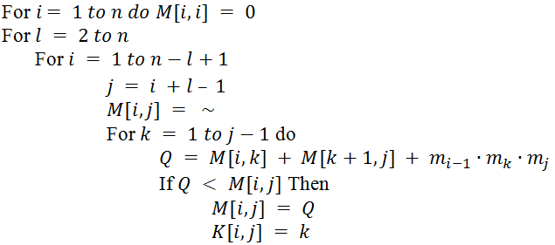
Matrix Multiplication Algorithm
Matrix Chain Order(K)

Slide 13
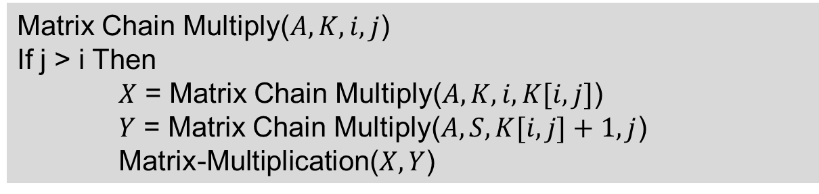
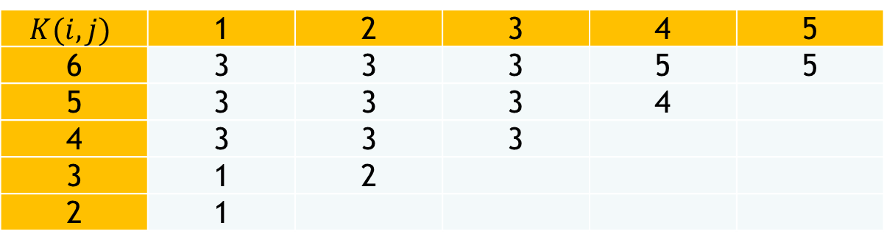
Final Result
$$K(i,j)$$ | 1 | 2 | 3 | 4 | 5
6 | 3 | 3 | 3 | 5 | 5
5 | 3 | 3 | 3 | 4
4 | 3 | 3 | 3
3 | 1 | 2
2 | 1
Matrix Chain Multiply($A,K,i,j$)
If j > i Then
$X$ = Matrix Chain Multiply($A,K,i,K[i,j]$)
$Y$ = Matrix Chain Multiply($A,S,K[i,j]+1,j$)
Matrix-Multiplication($X,Y$)
The results of Matrix Chain Multiply(A,K,1,6) example above is ((A₁(A₂A₃))((A₄A₅)A₆))

